Slide 1

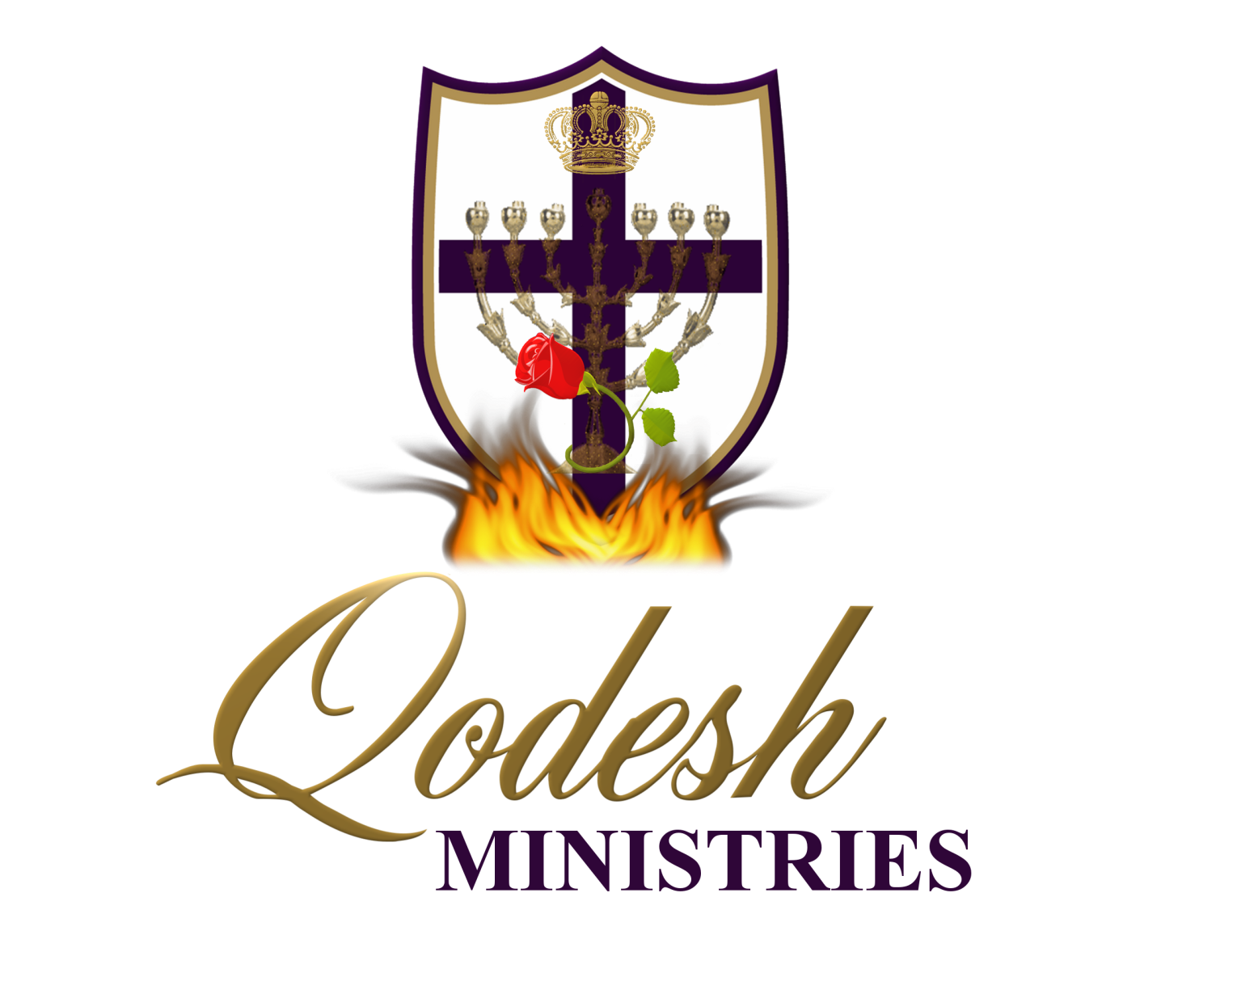

Slide 2
RECOGNITION
THE MESSIANIC PROPHECY BIBLE PROJECT
http://www.messianicbible.com
HEAR O ISRAEL
www.hearoisrael.org
SHEEPFOLD GLEANINGS WRITTEN BY JULIE PARKER
www.sheepfoldgleanings.com
MESSIANIC ISRAEL ALLIANCE
http://www.messianicisrael.com
AZAMRA TORAH FOR OUR TIME – RABBI AVRAHAM GREENBAUM
http://www.azamra.org

Slide 3
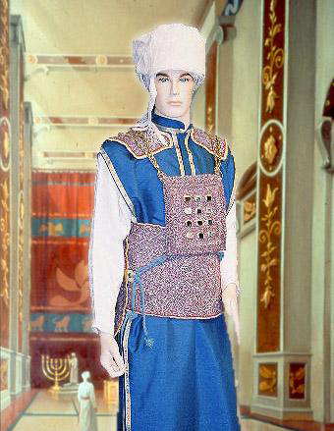
TETZAVEH “You shall command”
Torah: Exodus 27:20 – 30:10
Haftorah: Ezekiel 43:10-27, 1 Samuel 15: 2–34
B’rit Chadashah: Matthew 13:1-53, Hebrews 13:10-16, Romans 12:1 to 13:14
All references: The Scripture 1998+ unless otherwise noted

Slide 4
WHY THE TABERNALCE
The purpose of the tabernacle was so that יהוה might dwell among the children of Israel. At closer inspection we see a pattern for יהוה dwelling among His people:
From the chart above, only the 2nd half of number 3 is left to fulfil! And when we get there, it’s forever!
יהוה walked in Eden with Adam and Eve | יהושע walked among the people
יהוה tabernacled among His people (temporary dwelling) | You are the tabernacle of the Holy Spirit 1 Cor. 3:16 (temporary dwelling)
יהוה dwelt in the Temple (permanent dwelling in Jerusalem) | יהוהwill dwell permanently with us in (forever in Jerusalem) Rev. 21:10

Slide 5
A HOUSE
The first letter (Hebrew reads right to left) of the first word (In the beginning) of (Genesis) is an enlarged bet (ב). It appears in the Torah scrolls like this:
בראשׁית
The Hebrew letter bet (ב) is a picture of a house and from the first letter of the Scriptures we learn that it is the desire of our Creator to have a relationship with those He will create. A house is a picture of a Bridegroom who takes a wife and has a family. The Tabernacle will become a picture of that house that He desires to dwell in with His family.
The Tabernacle was a large tent, furnished within as a small apartment with a table and a lamp. It was meant to represent יהוה’s home on earth, a visible affirmation that He accompanied the people through their wilderness wanderings. The Tabernacle mirrors every individual’s personal journey out of Egypt and their continuing trek to the betrothal spot on Mount Sinai.

Slide 6
TWO PRIESTHOODS
Now the summary of what we are saying is: We have such a High Priest, who is seated at the right hand of the throne of the Greatness in the heavens, and who serves in the set-apart place and of the true Tent, which יהוה set up, and not man. For every high priest is appointed to offer both gifts and slaughters. So it was also necessary for this One to have somewhat to offer. For if indeed He were on earth, He would not be a priest, since there are priests who offer the gifts according to the Torah, (Hebrews 8:1-4)
The Bible teaches two priesthoods:
Levitical
Melchizedek
What Moses saw up on Mt. Sinai was a picture of the order of Melchizedek a picture of the true tabernacle. To make earthly Tabernacle accordingly you need wisdom from יהוה. That is why it was so crucial that Moses followed “exactly according to that pattern He showed him”.

Slide 7
APPOINTMENT OF HIGH PRIEST
What we must remember as we read that what we’re reading is not necessarily in chronological order. Rabbi Avraham Greenbaum writes:
“It must be understood that Ein Mukdam O Me-Uchar B’ Torah or There is no ‘before’ and ‘after’ in Torah. The reason for the appointment of Aaron and his sons and none other to be the priests ministering in the House does not become apparent in the Torah narrative until next week's parshah of KI TISA, with the account of the sin of the Golden Calf. Yet even before the reason became manifest, their appointment was already conceived in the mind and will of G-d prior to that event, as we see from this week's parshah of TETZAVEH. The first-born of the Children of Israel were originally offered an opportunity to become the ones who would serve as the priests. Indeed at the Giving of the Torah, it was the first-born -- the ‘lads’ -- of the Children of Israel who officiated at the sacrifices, as we read in MISHPATIM”.

Slide 8
FIRST BORN
And Mosesh wrote down all the Words of יהוה, and rose up early in the morning, and built an altar at the foot of the mountain, and twelve standing columns for the twelve tribes of Yisra’ĕl. And he sent young men of the children of Yisra’ĕl, and they offered burnt offerings and slaughtered peace slaughterings of bulls to יהוה. (Exodus 24:4-5)
The Hebrew word here, “na’ar’i” is also the word for “young male servants” and shares the ministry of the “first-born”. Rabbi Greenbaum concludes:
“However, with the sin of the Golden Calf (told next week in KI TISA), the first-born of the Children of Israel failed the crucial test. From that time on, the Priesthood was given to Aaron and his descendants as an hereditary gift for all time”.

Slide 9
WALK TROUGH THE TABERNACLE
As a priest, we first encounter the Altar where sacrifices are offered. Beyond the Laver for washing, we enter a Holy area where we notice the bread set on the Table of Showbread, fire from the Menorah at night, and smoke from the Incense Altar by day. All these elements are pointing to the primary vessel… the Ark that houses the Torah. It is behind a curtain, in the same way that Mount Sinai was cloaked in darkness and clouds. Sacrifice, fire, manna, and smoke are all visible lessons for the children of Israel – not just for those who left Egypt, but for future generations. The lessons from the desert are eternal lessons.
Today there is only one vessel from the Tabernacle that has survived in synagogues and Messianic congregations. It is the Menorah. In Revelation, we see יהושע speaking to His disciple John from the midst of seven Lampstand’s…Menorahs…which we are told symbolize seven congregations:

Slide 10
SEVEN GOLDEN LAMPSTANDS
And I turned to see the voice which spoke with me. And having turned, I saw seven golden lampstands, and in the midst of the seven lampstands One like the Son of Aḏam, dressed in a robe down to the feet and girded about the chest with a golden band. ... And when I saw Him, I fell at His feet as dead, and He placed His right hand on me, saying, “Do not be afraid, I am the First and the Last, and the living One. And I became dead, and see, I am living forever and ever. Amĕn. And I possess the keys of the grave and of death. .. “The secret of the seven stars which you saw in My right hand, and the seven golden lampstands: The seven stars are messengers of the seven assemblies, and the seven lampstands which you saw are seven assemblies.
(Revelation 1:12-20)
The Menorah has survived over 3,000 years as a symbol of the Presence of the Father. The Menorah is one of the oldest symbols of Israel. It has been found engraved on rocks, coins, and depicted on ancient mosaics.

Slide 11
MENORAH
The Menorah’s shape of a central stem with branches extending from either side gives the impression of a tree. Even the way the Menorah is described supports that image: stems, branches, flowers, etc.
The Menorah by itself is not the light. The Menorah is the stand that holds the lights. The lights are fed by oil. Some translations call Menorahs candlesticks, but they didn’t even have candles back then. Even the translation “lampstand” doesn’t give the true picture of the oil fed Menorah. The true picture of the Menorah:
“You are the light of the world. It is impossible for a city to be hidden on a mountain. “Nor do they light a lamp and put it under a basket, but on a lampstand, and it shines to all those in the house. “Let your light so shine before men, so that they see your good works and praise your Father who is in the heavens. (Matthew 5:14-16)

Slide 12
AND YOU, YOU
“And you, you are to command the children of Yisra’ĕl ...
(Exodus 27:20)
While this weeks Parsha is known simply as “Tetzaveh” in Hebrew; it actually appears in the Hebrew Torah as, “V’ attah tetzaveh”. The rabbis point out that, from the time of Moses’s birth in the beginning of Exodus, until his death at the end of Deueronomy, this is only Torah portion where his name is not mentioned. Instead, we have “attah” or “you”.
So, why not mention Moses by name? The explanation that the rabbis point out is that the focus of this week’s Torah portion is focused on the “priests”. Aharon and his seed were those chosen as priests to minister to Elohim. Moses, on the other hand, was the “Prophet”.
We are to pay close attention to all the Torot of the priests, as we were called to be a “Kingdom of Priests” and not a “kingdom of prophets”. Most ministers have forgotten the mission as it’s more glamorous to be a prophet.

Slide 13
FIRST TABERNACLE COMMAND
“And you, you are to command the children of Yisra’ĕl to bring you clear oil of pressed olives for the light, to cause the lamp to burn continually. “In the Tent of Meeting, outside the veil which is before the Witness, Aharon and his sons are to tend it from evening until morning before יהוה – a law forever to their generations, from the children of Yisra’ĕl. (Exodus 27:20-21)
The first command is for the upkeep of the Tabernacle is to make sure there is enough “zak shemen zayeet” or “pure oil of olives”, “katiyt” or “hand crushed in a mortar” to keep the Menorah lit “tamyid” or “continually”.
Aharon and his sons (the priests) were to “ya’arok” (“arrange” or “set in order”) from evening until morning, or daily, on behalf of the Children of Israel. As we are now High Priest according to the order of Malki-Tzedek, it is now our responsibility.

Slide 14
COMMAND
The first thing that we notice is that the command to bring the olive oil is different than the usual form of address. This is what we usually see:
• And you shall make…an Ark
• And you shall make…a Table, etc.
In fact, this phrase (and you shall make) appears 22 times in these few chapters in Exodus. Therefore what we read in Exodus 27:20 stands out all the more:“And you, you are to command the children of Israel ... Aside from the repeat of this verse in (Leviticus), the phrase “that they bring you” is found only one other time in all of the Tanakh (Hebrew Scriptures) and that is in the section on the red heifer:“
This is a law of the Torah which יהוה has commanded, saying, ‘Speak to the children of Yisra’ĕl, that they bring you a red heifer, a perfect one, in which there is no blemish and on which a yoke has never come. (Numbers 19:2)
In both commands they are told to bring something to Moses who will end up giving the oil/heifer to the High Priest.

Slide 15
MOSES
The placement of this verse in Exodus is interesting, as we see that it is the duty of the people to “bring to Moses” the oil for the lamps. Moses will not be the one to tend to the lamps or light the Menorah. All this will be done by the priests. Yet, despite this, we are told that Moses will have a special interest in the matter of the oil, for he is responsible for it. We know that fire and light symbolize the energy of the Spirit of יהוה. Moses, the Torah (the Living Word), becomes the essence through which the oil must be distributed.
There is a very interesting passage in Jeremiah that compares Israel to a green olive tree. The context of these verses is in regards to the destruction of the Temple. I think it may shed some “light” on all of this:
“יהוה has named you, ‘Green Olive Tree, Fair, of Goodly Fruit.’ With the noise of a great sound He has set it on fire, and its branches shall be broken. (Jeremiah 11:16)

Slide 16
ISREAL
Although Israel is compared to the “Green Olive Tree”, the prophet now speaks of that tree burning, with “its branches broken”. The pure olive oil that is meant to kindle the light in the lamps of the Menorah is now used in kindling the flames of destruction. Israel is compared to various trees throughout Scripture.
Why does Jeremiah compare Israel to an olive tree? It has all got to do with the harvesting process to be discussed later. So it is with Israel, they are beaten and oppressed with yokes until they (we) finally repent. Then in their distress they become “a Green Olive Tree, lovely and with good fruit.”
Another characteristic about oil is that when it is stirred with other fluids, it does not mix. It always stands apart. This is true for Israel. They do not mix with idol worshippers. All other fluids can be mixed up so that you cannot tell what is what. But when you stir oil with other fluids, the oil will always remain on top.

Slide 17
ALL OF US
Now back to our verse in Jeremiah….the branches are broken, the tree has been burnt, but not the roots! The tree that originally was intended to light an eternal flame has gone through the process of destruction only to once more thrive and produce pure oil for the light!
And now….who does our parasha tell us is responsible for that oil? It is Moses! It is the Torah! To begin the process all over again, we must begin with the commandment to RETURN TO Moses the pure oil!
“And you, you are to command the children of Yisra’ĕl to bring you clear oil of pressed olives for the light, to cause the lamp to burn continually. (Exodus 27:20)
ALL of Israel is commanded to bring the oil. The duty does not belong to a selected group of people. Every citizen of Israel must bring to Moses the clear olive oil pressed for the light.

Slide 18
CIRCUMVENTING MOSES
Thus Moses cannot be circumvented when it comes to the oil of Torah and also the red heifer sacrifice. The red heifer purifies from death and must be flawless and without blemish. It purifies everyone that has come in contact with death. The sacrifice is a reminder that we are destined to return to a world where there is no death. Death occurs in our world as a consequence of the original sin. As soon as man was cut off from his roots (oil of Torah), death became a reality.
יהושע is our red heifer sacrifice. He fulfilled every requirement of Moses (Torah). Now following in His footsteps, the children of Israel also must come through Moses in order to be the pure oil that can be used in the Menorah which is the light to this dark world.

Slide 19
LIGHT PRODUCERS
The book of Romans gives us further insights into how Messiah has enabled believers, who produce oil by keeping Torah, to be grafted into this olive tree who is Israel:
Now if the first-fruit is set-apart, the lump is also. And if the root is set-apart, so are the branches. And if some of the branches were broken off, and you, being a wild olive tree, have been grafted in among them, and came to share the root and fatness of the olive tree, do not boast against the branches. And if you boast, remember: you do not bear the root, but the root bears you! You shall say then, “The branches were broken off that I might be grafted in.” Good! By unbelief they were broken off, and you stand by belief. Do not be arrogant, but fear. For if Elohim did not spare the natural branches, He might not spare you either. ..For if you were cut out of the olive tree which is wild by nature, and were grafted contrary to nature into a good olive tree, how much more shall these who are the natural branches, be grafted into their own olive tree? (Romans 11:16-24)

Slide 20
PATTERN OF CREATION
Light was created first:
And the earth came to be formless and empty, and darkness was on the face of the deep. And the Spirit of Elohim was moving on the face of the waters. And Elohim said, “Let light come to be,” and light came to be. (Genesis 1:2-3)
יהושע is the light that was created before all things were created.
“יהוה possessed me, The beginning of His way, As the first of His works of old. “I was set up ages ago, at the first, Before the earth ever was. “When there were no depths I was brought forth, When there were no springs heavy with water. “Before mountains were sunk, Before the hills, I was brought forth, “Before He had made the earth and the fields, Or the first dust of the world. (Proverbs 8:22-26)
Therefore יהושע spoke to them again, saying, “I am the light of the world. He who follows Me shall by no means walk in darkness, but possess the light of life.”(John 8:12)

Slide 21
WHY?
The “Light”, represents the Word of Elohim, the Torah. נ
Your word is a lamp to my feet And a light to my path. (Psalms 119:105)
When you are walking about, it leads you; When you lie down, it guards you. And when you have woken up, It talks to you. For the command is a lamp, And the Torah a light, And reproofs of discipline a way of life, (Proverbs 6:22-23)
Turning back to God, it is light that will shine on our path:
If you return to the Almighty, you are built up. If you remove unrighteousness far from your tents, and lay your gold in the dust, and the gold of Ophir among the stones of the wadis, then the Almighty shall be your gold and your silver, strength to you. Then you shall certainly delight in the Almighty, and lift up your face to Eloah, make your prayer to Him. And He shall hear you, and you shall pay your vows. And whatever you decide on shall be established for you, and light shine on your ways.
(Job 22:23-28)

Slide 22
SYMBOLISM
We cannot see light, but we must have light to truly see. Similarly we know we cannot see יהוה, but we can see wherever He shines His light
For with You is the fountain of life; In Your light we see light. (Psalms 36:9)
We can’t see the Father, but we can definitely see Him in action. His name יהוה is a verb, not a noun. This is similar to how the workings of the Spirit are described byיהושע :
“The Spirit breathes where it wishes, and you hear the sound of it, but do not know where it comes from and where it goes. So is everyone who has been born of the Spirit.” (John 3:8)
As the sun rises every morning, it should remind us that our Creator called everything into being by His declaration:
And Elohim said, “Let light come to be,” and light came to be.
(Genesis 1:3)

Slide 23
THE LIGHT
It must be noted that these first two verses are about the Menorah (Lamp) and its “light” are not included with the others describing the utensils in last week’s parsha. Instead, these are our introduction to the garments and service of the High Priest and the priests who would serve under him. Why?
In the Mishkan, this “Light” illuminates the “Kodesh” or “Set-apart Place” or the “Holy Place”, which is separated, by the veil, from the “Kodesh Kodesh’im” or “Most Set-apart Pace”, the “Holy of Holies”, where the Ark of the Covenant was kept; which contains the “Tablets” of the Covenant, or the “Witness”. The Hebrew word used here for “Witness” is “eyd” (ayin-dalet) which means “testimony” or “witness”. These “Ten Words”, these “Commandments” on these “Tablets” are the “Testimony” of Elohim. They did and will testify, or be a witness, against us when we sin and they’re our covering when we walk in His Word.
Question: Where did the light come from behind the veil in Holies of Holies?

Slide 24
THE MENORAH DUAL MESSAGE
Rabbi Naftali Silberberg writes “Light is a metaphor for the Torah, which sheds light in a world of darkness, illuminating it with G-dly wisdom. In a world where the divine truth is concealed, the Torah is a beacon of light which illuminates the path to a spiritual, meaningful and fulfilling life. The menorah is also a symbol of Jewish unity. Every Jewish soul is unique, possessing a distinctive nature and temperament. This is because each individual soul emanates from a unique combination of G-d’s seven attributes: kindness, discipline, harmony, perseverance, humility, attachment and royalty. The seven branches of the golden menorah symbolize the idea that, although we may expresses ourselves differently and possesses different dispositions, we all share the same essence, an essence of pure gold. In fact, the menorah wasn’t a combination of parts which were screwed—or even welded—together; rather, it was a single golden slab which was hammered into the shape of a menorah. Not only are we all of the same substance, but we are actually a part of a single non-composite entity, one large menorah.”

Slide 25
OLIVE OIL - Background
Olive oil is made by crushing and pressing ripe olives. Whole olive fruit consists of 10 to 40 percent oil, and the fruit pulp is 60 to 80 percent oil. Producers use hydraulic presses to squeeze the oil out of the fruit under low pressure. This technique, called cold pressing, generates little heat, and so the oil retains its flavour, colour, and nutritional value.
Cold-pressing commonly is carried out in several stages, with only some of the oil being extracted at each stage. The process remains basically the same throughout, but the quality of the oil declines with each pressing. In most cases, olives are cold-pressed at 40 °F (4 °C).
The first pressing gives the highest quality oil, which is usually called virgin olive oil. Virgin olive oil is more expensive than other vegetable oils, so it often is considered a gourmet item. The lower-quality oils from later pressings are often blended in small amounts with such refined oils as soybean or cottonseed oil. Olive oil that comes from the final pressing is inedible. This oil, called olive residue or olive foots, is used in cosmetics, detergents, soap, medicines, and textiles.

Slide 26
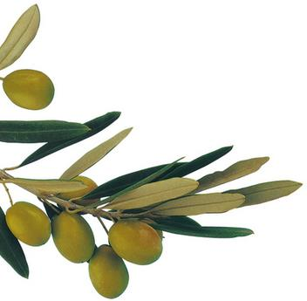
OLIVE
The fruit may be oval or oblong. As it matures, it turns from green to yellow to red to purple-black. It has a smooth skin, and its flesh surrounds a hard pit. Both the flesh and the seed in the pit contain oil, which makes up smooth skin, and its flesh surrounds a hard pit. Both the flesh and the seed in the pit contain oil, which makes up 10 to 40 percent of the mature fresh fruit’s weight. Fresh olives contain oleuropein, a bitter substance that makes them unpleasant to eat before processing. During processing, this substance is largely or entirely removed.
The olive tree’s bark and leaves are a soft gray-green, and its trunk becomes gnarled as it ages. Olive trees live longer than most other fruit trees. There are olive trees in [Israel] that may be more than 2,000 years old.
An olive tree blooms in late spring with clusters of white flowers. Depending on the variety, there can be anywhere from ten to over forty flowers in a cluster, but only one in every twenty flowers will become an olive. Olive trees are self-pollinating by means of the wind. Most varieties of olive trees bear a large crop one season and a small crop the next.

Slide 27
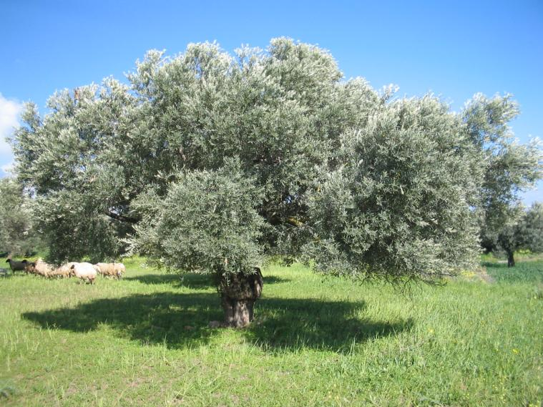
OLIVE TREE
Olive trees prefer a hilly terrain and grow best at one to two thousand feet above sea level in lime soil. These trees are small, with deep roots, thirsty, with small olives and pits, and a high content of oil particles. In early autumn and spring the soil in the groves is ploughed and weeded, and the trees pruned. Pruning is most important and is labour intensive. You must thin the growth on the crown of the tree so the fruit-bearing branches can be exposed to the sun and air.
Parts cut off from an olive tree may take root and grow into new trees. The olive tree will grow where the climate is hot and dry. But for bearing good fruit, the tree needs a moderate supply of water.
Harvesting olives requires careful handling. Olives grown for their oil may be mechanically harvested. Olives grown for eating must be picked by hand. Most green olives are prepared by the Spanish process. In this process, unripe, yellowish-green olives are placed in lye solution. The lye removes most of the bitter taste. The olives are washed and then fermented in brine.

Slide 28
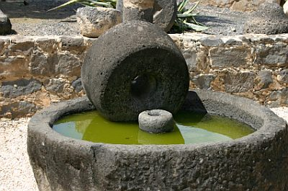
HARVESTING OLIVES IN ISRAEL
Olive oil production in Israel is an interesting process that has many life lessons about our latent potential.
The workers come and spread out big sheets under the trees and then using sticks, they beat the branches until the olives fall off. They are gathered in the sheets and made into pure olive oil.
In order to make the olives palatable and obtain the pure olive oil, the bitter juices are ground and then squeezed in an olive press. Since green olives produce a more bitter oil, they remain under the mill stone for 30 or 40 minutes, or sometime a heavy rock, to extract the bitterness and improve the flavour.

Slide 29
MOTHER DROP
Adam Clarke, in his biblical commentary, says regarding Exodus 27:20 that the very ripe and oil-filled olives, after having been picked, when slightly bruised or pressed (before being crushed by mortar stones in a mill) will express the purest, most flavourful and highest quality oil. This oil that flows spontaneously with little or no application of force is called the mother drop.
According to the Stone Edition Chumash, only the purest oil could be used for the lamp (menorah)—the purest of the pure! This was obtained by slightly pressing the very ripe olives, but without crushing them. A minute quantity of oil would be squeezed out—only a drop or so—from each olive. This oil was more pure than any of the other oil subsequently obtained via crushing.

Slide 30
SYMBOLISM FOR US
Just as the olives are beaten off the olive trees, gathered, and then squeezed or ground up to obtain the oil, similarly, we are like them.
Just as it takes a serious beating to get those olives off the branches, sometimes it feels like we are taking a beating in life, too.
Those bitter juices need to be pressed and squeezed out of us in order that we can be used by the Lord.
And just as it took the finest and purest olive oil to light the lamps in the Holy Temple, we too need the pure oil of the anointing to burn brightly for the Lord.
So despite the beating, pressing and grinding that we experience, we should be patient and not give up hope. The Book of James tells that we need to allow patience to do its job when we are tested, so that we will be complete and whole, lacking nothing in our characters (James 1:2-4). Only then will we end up with enough of the pure olive oil to keep our lamps lit until the break of day.

Slide 31
LIGHT TOUCH
With regard to the pressing of the olives to produce the purest oil, it must be noted that our Heavenly Father prefers to use a light touch/hand on us rather than a heavy one, to motivate us to do his will and to achieve our highest potential and fruitfulness in his kingdom. You don’t spank your kids when a quiet word will do. But if they don’t obey your quiet instruction, then you turn up the heat on them (see Ps 32:8–9 and Isa 30:21).
Similarly, if a slight pressing or crushing of the olive doesn’t achieve the results in us for which our Father is looking—the expressing out of us of the pure drops of fine and pure oil, he will be forced to begin crushing us more vigorously —pits, skins and all (our body, soul and spirit). The oil from the full crushing will contain some sediment which will later have to be filtered out (through the trials, adversities and refining fires of life). This oil will be of a lesser quality. 2 Corinthians 4:6–18 and Colossians 3:1–10.

Slide 32
LIVING EXAMPLE
We have been given the most pure "oil" in creation, for which יהושע was beaten. Our Messiah paid the price for our salvation WILLINGLY and for the precious gift of the Holy Spirit. He was "pierced through for our transgressions, He was crushed for our iniquities...and by His scourging we are healed" (Isa. 53:5). After His resurrection He told His disciples, "...but you will receive power after the Holy Spirit has come upon you" (Acts 1:8).
Just as it is the duty of the priests to trim and tend the lamps (the lights of the Menorah), to cleanse the bowls at the top of the stem and six branches, refill each of them with pure beaten olive oil offered by the people, and keep the soaked wicks lit. It is our responsibility to trim our own wicks ("forgetting those things that are behind"), be filled up with the Holy Spirit ("oil of anointing"), proclaim His truth ("in demonstration of the Spirit and of power"), and in so doing, burn brightly, as a ("light of the world).“ We are reminded of the Master's words in Matthew concerning the Ten Virgins, where He warned, "...but the prudent took oil in flasks along with their lamps" (Matt. 25:4). Be filled, and refilled, with the Spirit daily!

Slide 33
10 VIRGINS
“Then the reign of the heavens shall be compared to ten maidens who took their lamps and went out to meet the bridegroom. “And five of them were wise, and five foolish. “Those who were foolish, having .. lamps, took no oil with them, but the wise took oil in their containers with their lamps. (Matthew 25:1-4)
Five is a reference to the five books of Moses (Torah). Moses wrote about יהושע (John 5:46-47). The five wise virgins are believers with an adequate supply of oil, who live in accordance with the testimony / covenant of Moses and walk in the Spirit of יהושע, obeying His Word.
The five unwise virgins are believers who lack enough oil in their walk and who, over time, purposefully neglected to appropriate יהושע’s words into their heart and lifestyle. It is a commandment to keep the oil in the lamp burning perpetually.
יהושע is the only oil that produces the light for the menorah. Torah and the commandments on their own cannot produce oil or, therefore, light. Only when יהושע and Torah come together in our hearts will the oil produce the light in that day.

Slide 34
GARMENTS OF LIGHT
In Exodus 28 we read about the garments of the Kohen HaGadol (the High Priest). The rabbis refer to the garments of the High Priest as the “Garments of Light”. Since the priests serve HaShem me’et (on behalf of) B’nei Yisra’el, their service represents how Israel is to serve Elohim. This is reflected in the characteristics of Elohim that are studied during the “Counting of the Omer” following Pesach. There are several pictures in these “Garments of Light”, reflecting HaShem’s Spirit to us:
Bless יהוה, O my being! O יהוה my Elohim, You have been very great: You have put on excellency and splendour, Covering Yourself with light as with a garment, Stretching out the heavens like a curtain, Who is laying the beams of His upper rooms in the waters, Who is making thick clouds His chariot, Who is walking on the wings of the wind, Making His messengers the winds, His servants a flame of fire. (Psalms 104:1-4)

Slide 35
ARMOUR OF LIGHT
We are also commanded to put on the armour of light:
The night is far advanced, the day has come near. So let us put off the works of darkness, and let us put on the armour of light. (Romans 13:12)
The night is far gone and the day is almost here. Let us then drop (fling away) the works and deeds of darkness and put on the [full] armor of light. (Romans 13:12 AMP)
Because of this, take up the complete armour of Elohim, so that you have power to withstand in the wicked day, and having done all, to stand. ..(Ephesians 6:13-18)
For you were once darkness,but now you are light in the Master. Walk as children of light –for the fruit of the Spirit is in all goodness, and righteousness, and truth. proving what is well-pleasing to the Master. (Ephesians 5:8-10)

Slide 36
GOLDEN GARMENTS
There are eight garments that the Kohen “And you, bring near Aharon your brother and his sons with him, from among the children of Yisra’ĕl, for serving as priest to Me: Aharon, Naḏaḇ and Aḇihu, Elʽazar and Ithamar, the sons of Aharon. “And you shall make set-apart garments for Aharon your brother, for esteem and for comeliness. ..“And these are the garments which they make: a breastplate, a shoulder garment, a robe, an embroidered long shirt, a turban, and a girdle. .. “And you shall make a plate of clean gold and engrave on it, like the engraving of a signet: SET-APARTNESS TO יהוה. “And you shall put it on a blue cord, and it shall be on the turban – it is to be on the front of the turban. “And it shall be on the forehead of Aharon, .. “And make linen trousers for them, to cover their nakedness, ..(Exodus 28:1-43)
HaGadol was to wear. These are referred to also as the “Golden Garments”, because of the gold that was in most of them. “Gold” is representational of HaShem’s love for us. And, since the High Priest bore the guilt of all the “set-apart offerings” of the Children of Israel, each garment also symbolized the atonement of specific kinds of sins.

Slide 37
DIGNITY AND SPLENDOR
“.. expressing dignity and splendor. (Exodus 28:1-2 CJB)
Some translations state that these set-apart, or holy, garments were to be made for “honor” and “glory”. As Rabbi Chaim Richman: “As inaccurate as these words are translated into English, (kavod = ‘honor’, - more accurately alludes to the manifestation of the Divine presence on earth, and tiferet – ‘glory’ - more correctly describes a sublime harmony, a supremely peaceful and tranquil expression of beauty and splendor), it is clear that the holy garments to be fashioned for Aharon are intended to serve a purpose unlike those of ordinary clothes. The honor and glory, with which the priestly garments are commanded to embody, are not the honor and glory of Aharon, nor of any future high priest that would one day wear them. The honor and glory they are meant to evoke is the honor and glory of G-d. Again, unlike all other garments which are intended to draw attention to the wearer, the priestly garments are meant to envelop the wearer in the Divine presence and splendor of G-d. And this truly was the purpose of the creation of man, the crown of G-d's creation - to reflect and to establish the Divine presence in this world.”

Slide 38
MATERIALS
“And they shall take the gold, and the blue and the purple and the scarlet material, and the fine linen ,(Exodus 28:5)
The materials needed are the same colours and fabrics used for the curtains that divided the three sections of the tabernacle/mishkan, the one difference being the added gold threads. Only the priestly garment had the gold thread running through the multi-coloured fabric. This tied in directly to the furniture in the mishkan that was to be made of pure gold or acacia wood covered in pure gold. The furnishings represent different aspects of יהושע’s ministry, thus the priestly garments have a “divine” nature about them. The gold thread in the priestly garments connected directly to the divine nature and ministry of יהושע. When the priest wore the garments, he was walking and serving in a heavenly dimension.
Note: The Gold thread was produced by beating pure gold into thin sheets, rolling them and then cutting them into fine threads.

Slide 39
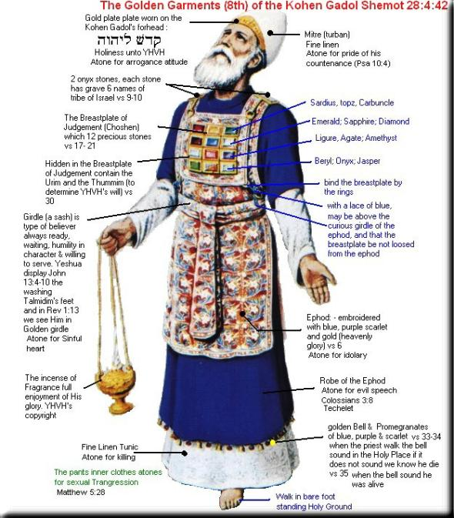
SHOULDER GARMENT “EPHOD”
"They are to make the ritual vest of gold, of blue, purple and scarlet yarn, and of finely woven linen, crafted by a skilled artisan. Attached to its front and back edges are to be two shoulder-pieces that can be fastened together. .. Take two onyx stones .. Mount the stones in gold settings.. (Exodus 28:6-14 CJB)
The ephod atoned for the sin of idolatry. Its is likened to an apron; it was worn to cover his back and was on top of his other garments, and was fastened by a long belt in the front, opposite his heart. This belt was woven into the entire length of the ephod's upper hem. There were also two shoulder-straps that were sewn onto the belt. The settings for the two sardonyx, or shoham or onyx stones were attached at the ends of these straps, on the shoulders. The ephod covered the back of his body. Some opinions describe it as a sort of half-cape; others, more like a skirt. It was long and it extended from just below his elbows, all the way to his heels. It was slightly wider than a man's back, since it was to cover his back and extend a little towards the front on both sides as well, covering a portion of his belly from either side; thus insuring to cover the kidneys which represent the seat of the “inner man”.

Slide 40
AS A REMINDER
“And you shall take two shoham stones and engrave on them the names of the sons of Yisra’ĕl, six of their names on one stone, and the remaining six names on the other stone, according to their birth. “With the work of an engraver in stone, like the engravings of a signet, engrave the two stones with the names of the sons of Yisra’ĕl. Set them in settings of gold. “And you shall put the two stones on the shoulder pieces of the shoulder garment as stones of remembrance for the sons of Yisra’ĕl. And Aharon shall bear their names before יהוה on his two shoulders, for a remembrance. (Exodus 28:9-12)
The impression יהוה was giving to the twelve tribes of Israel was of an everlasting remembrance. The names of all twelve tribe are forever engraved in stone on His shoulders and forever remembered as memorial stones. יהושע is now the one carrying the tribes of Isreal before יהוה daily
For a Child shall be born unto us, a Son shall be given unto us, and the rule is on His shoulder. And His Name is called Wonder, Counsellor, Strong Ěl, Father of Continuity, Prince of Peace. Of the increase of His rule and peace there is no end, upon the throne of Dawiḏ and over His reign, to establish it and sustain it with right-ruling and with righteousness from now on, even forever. The ardour of יהוה of hosts does this. (Isaiah 9:6-7)

Slide 41
BREASTPLATE
"Make a breastplate for judging. Have it crafted by a skilled artisan; make it like the work of the ritual vest — make it of gold; blue, purple and scarlet yarn; and finely woven linen. When folded double it is to be square — a hand-span by a hand-span. Put on it settings of stones … The stones will correspond to the names of the twelve sons of Isra'el; they are to be engraved with their names as a seal would be engraved, to represent the twelve tribes. "On the breastplate, make two pure gold chains twisted like cords. Also for the breastplate, make two gold rings; and put the gold rings on the two ends of the breastplate. Put the two twisted gold chains in the two rings at the two ends of the breastplate; attach the other two ends of the twisted chains to the front of the shoulder-pieces of the ritual vest. Make two gold rings and put them on the two ends of the breastplate, at its edge, on the side facing in toward the vest. Also make two gold rings and attach them low on the front part of the vest's shoulder-pieces, near the join, above the vest's decorated belt. Then bind the breastplate by its rings to the rings of the vest with a blue cord, so that it can be on the vest's decorated belt, and so that the breastplate won't swing loose from the vest. (Exodus 28:15-28 CJB)

Slide 42
BREASTPLATE OF JUDGEMENT
The “Breastplate” was worn over the ephod or shoulder garment. By “bearing”, as Torah puts it, the names of the Sons of Yisra’el over his heart, and as we’ll as his shoulders, the High Priest signified that he bore the guilt of the people before HaShem and that Yisra’el, all twelve tribes, were to be constantly on his heart. The Breastplate atones for errors in judgment. The “Breastplate” is called in the Hebrew “choshen mishpat” which means “breastplate of judgment” or “decision”. The inner fold contained the "Urim V'tummim". There has been much speculation about the “Urim and Tummim”. Were they some kind of stones? The oral history, according to Yehudah, is that the Name of Elohim was written on pieces of parchment and placed inside the “Breastplate” which gave illumination to the stones in order to transmit HaShem’s judgments in certain situations. “Urim v’ Tummim” mean the “lights” and the “perfections”, or “revelations” and the “truth”, denoting the illumination of the questions and the perfection of the judgments given. These did not come from the contribution of the people; nor were they created by the craftsmen. These are, mysteries yet to be revealed.

Slide 43
PRECIOUS STONES “TREASURE”
The stones will correspond to the names of the twelve sons of Isra'el; they are to be engraved with their names as a seal would be engraved, to represent the twelve tribes..
The definition of seal is: as evidence of authenticity or attestation; a token or symbol of a covenant; something that authenticates or confirms; a final addition which completes and secures; the impression of one’s signet placed upon an article as evidence of a claim to possession; a mark of ownership; an impressed mark serving as visible evidence of something. Because of this, the Father continues to see every tribe and they are all “precious stones” before him! (Matthew 10:6; 15:24; John 18:9; Hebrews 8:1-2)
These twelve gemstones together represented Yisra’el as a treasure. We read in Shemot 19:5: Now therefore, if you will obey My Voice indeed, and keep My Covenant, then you shall be a peculiar treasure unto Me above all people: for all the earth is Mine, also, in Tehillim 135:4; For יהוה has chosen Ya’akov unto himself, and Yisra’el for His peculiar treasure.

Slide 44
THE ROBE
“And you shall make the robe of the shoulder garment all of blue. “And the opening for his head shall be in the middle of it, a woven binding all around its opening, like the opening in a scaled armour, so that it does not tear. “And on its hem you shall make pomegranates of blue and purple and scarlet material, all around its hem, and bells of gold between them all around: a golden bell and a pomegranate, a golden bell and a pomegranate, on the hem of the robe all around. “And it shall be upon Aharon to attend in, and its sound shall be heard when he goes into the set-apart place before יהוה and when he comes out, so that he does not die. (Exodus 28:31-35)
The “robe” was a four cornered garment made entirely of blue (techelet) wool dyed from the "Chilazon." This robe was to be made entirely of blue cloth and reflected the heavenly, divine side of יהושע. This robe atoned for evil speech or “lashon hara”. The pomegranates symbolize the “set-apart” or “kodesh” “fruits of the Ruach” that we are to walk in. The bells symbolize that we are to “proclaim” the words of Elohim and thus “illuminate” Torah to the nations

Slide 45
POMEGRANETS
Tradition says that the pomegranate fruit has 613 seeds, representing the 613 commandments or principles that govern the earth. The seeds are encased in twelve sections within the fruit, representing the twelve tribes encamped around the Tabernacle. The pomegranate is full of white, pearl-like seeds in a red fluid that represent the sweet, purifying redemptive work of the blood of the Lamb, יהושע, and that in His fruitfulness, each and every law יהוה gave would be like nectar, sweet to our soul.
The pomegranates can represent the House of Judah, the keepers of the good news of Torah, while the bells can represent the House of Israel, keepers of the good news of Messiah. When the two come together in unity they make a beautiful sound. If you have only bells without pomegranates (or, Torah), Paul said you are likened to a clanging cymbal. If you have only pomegranates (or, have only the Torah) and no bells (no Messiah), then it is like you are walking around with Torah and no sound, for Torah without Messiah is lifeless/dead. So pomegranates and bells work together to make a beautiful sound!

Slide 46
CROWN
“And you shall make a plate of clean gold and engrave on it, like the engraving of a signet: SET-APARTNESS TO יהוה. “And you shall put it on a blue cord, and it shall be on the turban – it is to be on the front of the turban. “And it shall be on the forehead of Aharon, and Aharon shall bear the guilt of the set-apart gifts which the children of Yisra’ĕl set apart in all their set-apart gifts. And it shall always be on his forehead, for acceptance for them before יהוה. (Exodus 28:36-38)
Some call it, the “crown” that also goes upon the head, on the turban, over the forehead. It was engraved with the words “Kadosh L’יהוה” or "Set-apart to יהוה." The Hebrew word here is “tzitz” (tzadee-yud-tzadee) which, as you know, means “wing” or “flower” and is very much related to the tzitzit on the corners of garments. This Gold Plate atoned for “arrogance”. “Rav Kook wrote that the Tzitz, fashioned out of pure gold, reflected the highest spiritual riches. The crown's placement on the forehead - the location of the ratzon, our inner will for good and holiness - symbolized the Kohen's aspirations for the most elevated good, as revealed within his inner soul”.

Slide 47
HOLINESS TO יהוה
The gold plate was to be engraved with the words ‘HOLINESS TO יהוה.’ It was attached to the turban by a blue cord (signifying the heavenly connection) and placed on the forehead. This engraving was to remind ourselves to self discipline our minds to think only pure holy thoughts before יהוה continually. As we are יהושע’s ambassadors, our thoughts should always reflect His thoughts and our speech always mirror His speech.
For the rest, brothers, whatever is true, whatever is noble, whatever is righteous, whatever is clean, whatever is lovely, whatever is of good report, if there is any uprightness and if there is any praise – think on these. And what you have learned and received and heard and saw in me, practise these, and the Elohim of peace shall be with you.
(Philippians 4:8-9)

Slide 48
TUNIC
“And you shall weave the long shirt of fine linen, and shall make the turban of fine linen, and you shall make the girdle of woven work. “And make long shirts for Aharon’s sons. And you shall make girdles for them, and you shall make turbans for them, for esteem and comeliness. “And you shall put them on Aharon your brother and on his sons with him, and shall anoint them, and shall ordain them, and shall set them apart, and they shall serve as priests to Me. (Exodus 28:39-41)
The “tunic” or “long shirt” (ketonet) which was made of pure white linen and was not woven with an ordinary cross-weave pattern; but, of a pattern consisting of many small boxes, or cells. There was absolutely no sewing or seams involved here with the exception of the arm-length sleeves, which were woven separately and afterwards sewn on. The tunic clung close to the body and extended from the priest's neck, down to the feet, just above the heels. Each tunic was made according to the priest's specific height and width. This tunic atones for “killing”. Yoseph’s “coat of many colors” is actually described in Torah, as a “ketonet pasim” means “tunic to the wrists and/or ankles”. In both cases, it’s the same garment.

Slide 49
TURBAN
…and shall make the turban of fine linen…(Exodus 28:39)
The High Priest “turban” (mitznepheth) which was made of white linen, wrapped around the head many times and was flat on top, while the regular priests’ turbans were “conical” or semi pointed on top. The turban was fashioned of a narrow strip of white linen, measuring 16 cubits (approximately 24 feet long). It was wound around the top of the priest's head after the manner in which one dresses a wound, wrapping the material lengthwise over and over. The turban atoned for “haughtiness” and sins in the “thoughts”.
Every scheme of the wicked in his arrogance [says], "There is no God, [so] it won't be held against me."
(Psalms 10:4 CJB)

Slide 50
BELT
“.. and you shall make the girdle of woven work. (Exodus 28:39)
The “belt” (abneyt) which was worn over the tunic, it was very long and made of white linen with 3 added colours. It was wrapped many times around the body, over the heart. The belt atoned for the “sins of the heart”. Josephus describes the belt as being hollow like the skin shed by a snake (Antiquities 3:7:2). It was a work of "embroidery". Although the belt itself was made of linen, the embroidery-a floral design-was done of coloured wool threads, and attached to the white linen background. This combination of wool and linen together in garments is normally forbidden (see VaYiqra 19:19), but it was permitted, even commanded, for the priestly garments; because the “korban’ot” or “offerings” he made were of both animal and plants.

Slide 51
SHORTS
“And make linen trousers for them, to cover their nakedness, reaching from the waist to the thighs. (Exodus 28:42)
The eighth, the “pants” (miknauce) were made of pure white linen, reaching from the waist to the knees. The priest's pants do not serve the same purpose as the other sacred garments. For all the other items which make up their uniform are "for honour and for beauty", as Scripture says. They esteem the sacred office and its dignity, not to mention their deeper significance. But this does not apply to the pants. We are specifically informed here that their function was one of modesty alone, to cover his nakedness. Thus, the pants atone for the sins of “sexuality”. These pants were closed; they did not have the usual openings which we are accustomed to. They were worn directly over the body. The tunic was placed over them. And according to most authorities, the upper hem was hollow and had a lace running through it, which was tied at the waist.

Slide 52
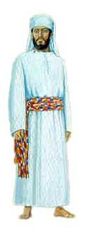
REST OF THE PRIESTS
“And make long shirts for Aharon’s sons. And you shall make girdles for them, and you shall make turbans for them, for esteem and comeliness. “And you shall put them on Aharon your brother and on his sons with him, and shall anoint them, and shall ordain them, and shall set them apart, and they shall serve as priests to Me. “And make linen trousers for them, to cover their nakedness, reaching from the waist to the thighs. (Exodus 28:40-42)
These priestly garments were made of linen and they too were created from threads consisting of six individual strands. These represent our covering. They remind us to set ourselves apart for our Bridegroom. The “tunic” atoned for “killing”, reminds us to “love one another”. The “pants” tell us to guard ourselves from “sexual sin”. The “turban” reminds us to guard our “minds” and bring our “thoughts” into subjection. And, the “belt” shows us to guard our “hearts”.

Slide 53
WEDDING GARMENTS
These white linen garments represent the righteous acts of the saints and were called the wedding garments of the bride.
After this I looked and saw a great crowd which no one was able to count, out of all nations and tribes and peoples and tongues, standing before the throne and before the Lamb, dressed in white robes, and palm branches in their hands, Revelation 7:9
These garments were not washed, as no provision in Torah called for that. When the High Priest’s colourful garments wore or they became stained, soiled or rendered un-wearable in the Presence of HaShem, they were not destroyed, but hidden so that they could not be found and worn by another.
When the priests’ white linen garments wore out, they were recycled several ways, such as wicks for the menorah in the temple and swaddling clothes for a newborn baby.

Slide 54
BARE FOOT
Why is the High priest barefooted?
Midrash tells us that when the brothers sold Joseph to the passing Ishmaelite's, the twenty pieces of silver they received in return was used by them to purchase shoes. This is reflected in the words of the prophet Amos: "because they sold the righteous for silver, and the needy for a pair of shoes." (Amos 2:6) When the brothers sold Joseph they violated this trust and profaned their own selves. The land, once welcoming and comforting now became foreign and hostile beneath their feet, just as it had become under the feet of Adam, after he violated his trust with G-d. By selling Joseph into exile, the brothers had, in turn, exiled themselves within their own land.
This is a living testimony to the unity of Israel and the repair of the breech caused by Adam's perfidy to G-d and the brothers' perfidy toward Joseph. It is the very strength and the power of this brotherly love and humility before G-d that enables the barefoot High Priest to perform his sacred tasks in comfort and with ease, despite the snows of winter and the blazing heat of summer.

Slide 55
CONSECRATION (7 STEPS)
They were taken from among the children of Israel (28:1). This prefigures divine election. יהוה calls or chooses each person. יהושע called his disciples (John 15:16–19). They did not call or choose him, but they had to respond to that call.
They were then brought into the door of the Tabernacle (29:4). The door of the Tabernacle is Messiah יהושע who is the door to the sheepfold. No man comes to the Father except through יהושע (John 10:1–18 and 14:6). The door is comprised of four colors, which speak of the person and work of יהושע: blue, scarlet, white and purple. It also speaks of the four Gospels, which is the door to understanding the Person and work of יהושע.
They were washed (29:4). Upon accepting the work and Person of יהושע, one must be immersed for the remission of sins (Acts 2:38) to identify spiritually with the death, burial and resurrection of יהושע (Rom 6:3–14), and the washing of the water of the Word (Eph 5:26).

Slide 56
CONSECRATION (7 STEPS)
They were clothed in their official garments (29:4–9). The redeemed believer is to put on the robes of righteousness. (Gal 3:27, “For as many of you as have been baptized into Messiah have put on ­Messiah.”) Paul talks about fruits of righteousness through יהושע in Philippians 1:11. Righteousness is Torah obedience (Ps 119:172) and is a mark of the end-time believers/saints (Rev 12:17 and 14:12) and of the bride of Messiah (Rev 19:8).
They laid their hands on the head of the animals that were sacrificed, blood was shed and sprinkled on Aaron and his sons, matzoh (unleavened bread) was waved and burnt, and they ate the flesh of the ram and the matzoh (29:10–26, 32–33). Each believer has to take personal responsibility for his own sins. The sacrifice of יהושע, the Lamb of Elohim, at the cross must become personal to each person each must have his own personal relationship with יהושע. Each must “eat” the flesh and “drink” the blood of יהושע individually (John 6:35–58). Communion pictures this and is a personal and individual matter.

Slide 57
CONSECRATION (7 STEPS)
They were anointed with oil (29:21). Each person must receive the Set-Apart Spirit (Ruach) of Elohim.
They are sanctified or set-apart for a special, divine purpose (29:44). Only after going through these steps is one set-apart unto יהוה as a set-apart priesthood doing the set-apart work of יהוה.
Only on the basis of following יהוה’s steps, as outlined above in a spiritual manner, can one have fellowship with the Father. And what was the result? Relationship with the Father!
Our faith in יהושע stays alive and vibrant because of the sacrifices of devotion and praise we offer up daily, morning and night. We are called to do the same work the priests of old did, but in a spiritual or fulfilled sense.

Slide 58
REGULAR BURNT OFFERING
"Now this is what you are to offer on the altar .. every day. ..Through all your generations this is to be the regular burnt offering at the entrance to the tent of meeting before Adonai. There is where I will meet with you to speak with you. (Exodus 29:38-42 CJB)
Rabbi Yosef Kalatsky “The Torah tells us that the Altar upon which the burnt offerings were brought was made of wood and was covered with a thin layer of copper. It is therefore referred to as ‘the copper Altar’ and ‘the Altar of burnt offerings.’ The Midrash states, that Moses said before G’d, ‘Master of the Universe, You had commanded me to make an Altar from Acacia wood and cover it with copper. You also told me that there will be a continuous fire that burns upon it. Will the fire not melt away the copper and burn the wood that is beneath it?’ G’d responded to Moses, ‘The fact that fire burns through copper and consumes wood is a phenomenon that exists within the physical realm. However, in the spiritual realm these laws do not apply. Gaze upon the angels. They are composed of a consuming fire. In addition, in the spiritual realm there are great amounts of ice, yet the fire of the angels does not melt it. Fire and ice coexist without interfering with one another.’”

Slide 59
TWO TEMPLES
"You are to make an altar on which to burn incense; ..Aharon will burn fragrant incense on it as a pleasing aroma every morning; he is to burn it when he prepares the lamps. Aharon is also to burn it when he lights the lamps at dusk; this is the regular burning of incense before Adonai through all your generations. ..(Exodus 30:1-10 CJB)
Rabbi Jonathan Sacks “What is the contemporary application of this passage? We have no Temple and no altar. Seemingly these laws have nothing to tell us in the present. This is, however, not so. For there are two kinds of Temple; and one kind cannot be destroyed. This is the Temple within each “PERSON”, where he still performs his service in an inward reflection of the service of the Sanctuary. When G-d told Moses to erect a Sanctuary, He said: "And they shall make Me a Sanctuary, and I will dwell in them," meaning, in the soul of every PERSON”. Thus, even though the physical Temple is destroyed, the inward Temple which each PERSON” makes within himself survives, indestructible. And the service which he conducts in the reaches of his soul mirrors in every respect the service of the Temple and Sanctuary. So their laws, which appeared at first sight to have no contemporary application, are in fact precise instructions for the inner life of the PERSON”

Slide 60
GARMENTS OF PRIESTHOOD
Put on the complete armour of Elohim, for you to have power to stand against the schemes of the devil. Because we do not wrestle against flesh and blood, but against principalities, against authorities, against the world-rulers of the darkness of this age, against spiritual matters of wickedness in the heavenlies. Because of this, take up the complete armour of Elohim, so that you have power to withstand in the wicked day, and having done all, to stand. Stand, then, having girded your waist with truth, and having put on the breastplate of righteousness, and having fitted your feet with the preparation of the Good News of peace; above all, having taken up the shield of belief with which you shall have power to quench all the burning arrows of the wicked one. Take also the helmet of deliverance, and the sword of the Spirit, which is the Word of Elohim, praying at all times, with all prayer and supplication in the Spirit, watching in all perseverance and supplication for all the set-apart ones; (Ephesians 6:11-18)

Slide 61
GARMENTS OF PRIESTHOOD CONT
So this is a person who is able to “stand against the wiles of the devil”. A question for you…would you rather your garments are seen as those of a pagan Roman guard or the garments of the priesthood?
There is evidence from the Hebrew Scriptures that the intended main teaching of Ephesians 6 was that of “priest,” a soldier in יהוה’s army who wears the “whole armour of Elohim”:
And He put on righteousness as a breastplate, and a helmet of deliverance on His head. And He put on garments of vengeance for clothing, and wrapped Himself with ardour as a mantle. (Isaiah 59:17)
How pleasant upon the mountains are the feet of him who brings good news, who proclaims peace, who brings good news, who proclaims deliverance, who says to Tsiyon, “Your Elohim reigns!” (Isaiah 52:7)

Slide 62
RESPONSIBILITY
If one takes on the garments of the priesthood, he must understand his mission:
“For the lips of a priest should guard knowledge, and they seek the Torah from his mouth, for he is the messenger of יהוה of hosts. (Malachi 2:7)
If a “priest forgets/rejects the Torah”, he is in danger of being “rejected”, resulting in the “destruction of His people”:
“My people have perished for lack of knowledge. Because you have rejected knowledge, I reject you from being priest for Me. Since you have forgotten the Torah of your Elohim, I also forget your children. (Hosea 4:6)

Slide 63
CHOSEN AND CALLED
We were “chosen” and “called” to be a “holy priesthood” (1 Peter 2:9). Unfortunately, not all of the “called” out will be “chosen” to attend the wedding feast for they do not have the proper “wedding garments”:
and he said to him, ‘Friend, how did you come in here not having a wedding garment?’ And he was speechless. “Then the sovereign said to the servants, ‘Bind him hand and foot, take him away, and throw him out into the outer darkness – there shall be weeping and gnashing of teeth.’ (Matthew 22:12-13)
But the “called” and the “chosen” will be with the “Lamb” in His battle against the enemy for they have been “faithful”:
“They shall fight with the Lamb, and the Lamb shall overcome them, for He is Master of masters and Sovereign of sovereigns. And those with Him are called, and chosen, and trustworthy.” (Revelation 17:14)

